Slide 1

Seasonal Agriculture Performance Analysis
Name : Harshvee Kotak
College Name: Narsee Monjee Institute of Management Studies
AICTE STU ID : STU614b10add76551632309421

Slide 2
PROBLEM STATEMENT
Environmental Conditions
Rainfall, temperature, humidity and soil moisture shift by season
Farming Practices
Irrigation method, inputs and crop choice vary across sowing cycles
Resource Availability
Water and input access differ between Kharif, Rabi and Zaid
Market Conditions
Prices and costs affect whether higher output turns into higher profit
Agricultural activities are shaped by seasonal shifts in environmental conditions, farming practices, resource availability and market conditions — so performance can differ sharply from one season to the next. Raw farm-level data, however, does not by itself reveal how performance changes across seasons or what patterns drive those differences.
01
02
03
The task: Analyze the seasonal agriculture dataset to uncover meaningful patterns, trends, relationships and variations in performance across Kharif, Rabi and Zaid — and turn them into evidence-based recommendations.
04

Slide 3
PROJECT DESCRIPTION
Explore, clean and prepare the seasonal dataset
Examine how performance varies across seasons
Identify seasonal patterns, trends and relationships
Compare yield, resource use and profitability by season
Apply statistical tests and visualization techniques
Turn evidence into data-driven recommendations
Project Objectives
The dataset captures farm-level agricultural activity across different seasons, states and farming conditions — covering environmental factors, farming inputs, crop yield, resource usage and economic outcomes. It provides an opportunity to investigate how seasonal conditions shape agricultural performance rather than performing a generic, unfocused analysis.
4,000 Farm Records
28 Data Columns
8 States Covered
3 Seasons: Kharif, Rabi, Zaid
8 Crop Types
4 Irrigation Methods

Slide 4







WHO ARE THE END USERS?
Farmers and Agronomists Farm Records
Plan sowing, irrigation and crop choice around season-specific performance
Agricultural Policy Planners Design seasonal support schemes using evidence rather than assumption
Agribusinesses and Input Suppliers Time input and services to when demand and returns are highest
Financial Institutions and Insurers Asses seasonal risk for farm credit, pricing and crop insurance
Researchers and Data Analysts Study seasonal drivers of yield, resource use and profitability
Government Agriculture Departments Support evidence-based seasonal planning at state and district level

Slide 5

TECHNOLOGIES USED
Python Primary programming language for data analysis and preprocessing
Pandas and Numpy Data loading, cleaning, transformation, aggregation and numerical computation
Matplotlib and Seaborn Visualization using bar charts, histograms, boxplots, violin plots, scatterplots and heatmaps
Scipy Statistical testing and hypothesis analysis
Jupyter Notebook Analysis, visualization and project documentation

Slide 6
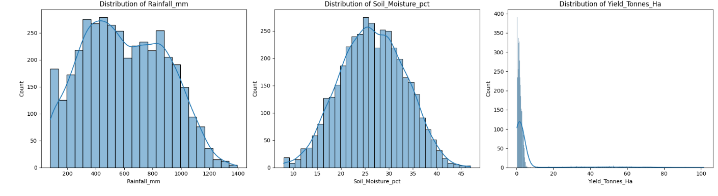
DATASET OVERVIEW & DATA CLEANING
4,000 Rows
28 Columns
3 Columns with missing values
<1.2% Max missing rate
Rainfall_mm, Soil_Moisture_pct and Yield_Tonnes_Ha had missing values (0.8%–1.2% of rows).
The affected variables were examined for distribution shape before imputation.
Missing values were treated using median/mean-based imputation, followed by a post-cleaning check.
Rainfall and soil moisture showed relatively stable distributions, while yield was strongly right-skewed. Median-based treatment was therefore preferred where appropriate to reduce sensitivity to extreme values.

Slide 7
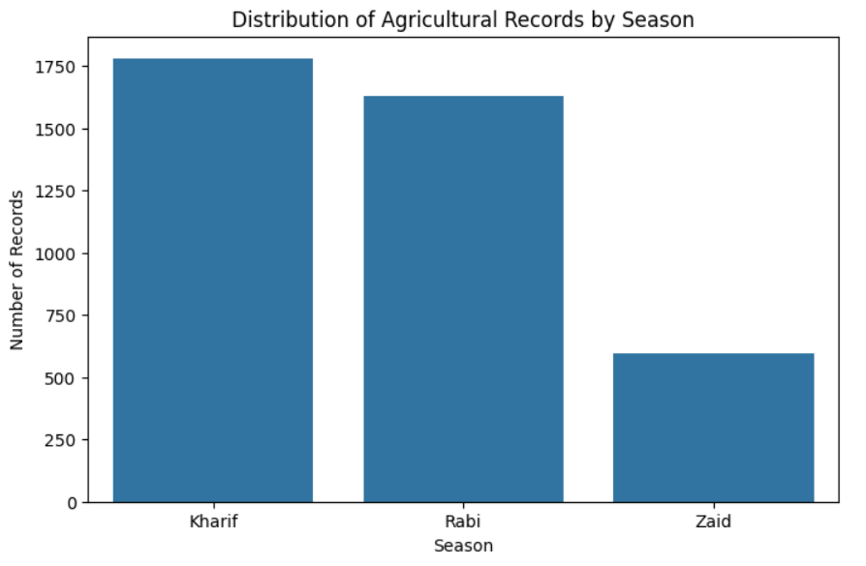
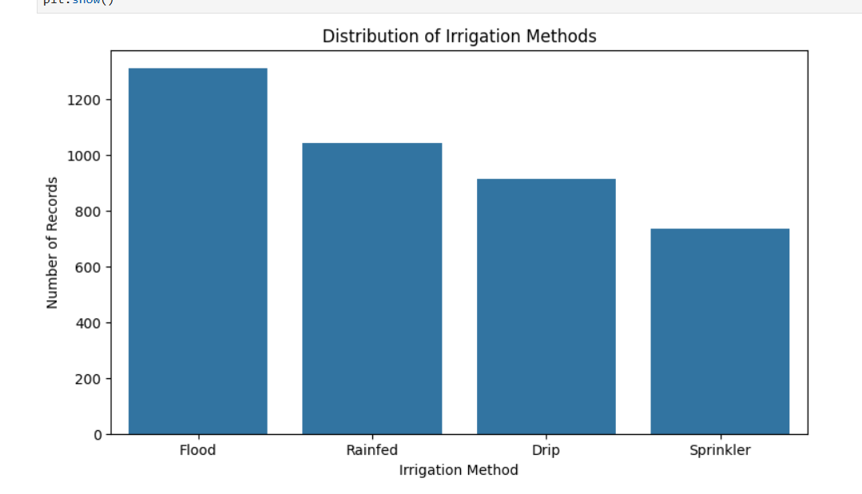
HOW THE DATASET IS DISTRIBUTED
Kharif accounts for the largest share of records (44.5%), while Zaid represents a much smaller 14.8%. Flood irrigation is the most common irrigation method (32.8%).

Slide 8
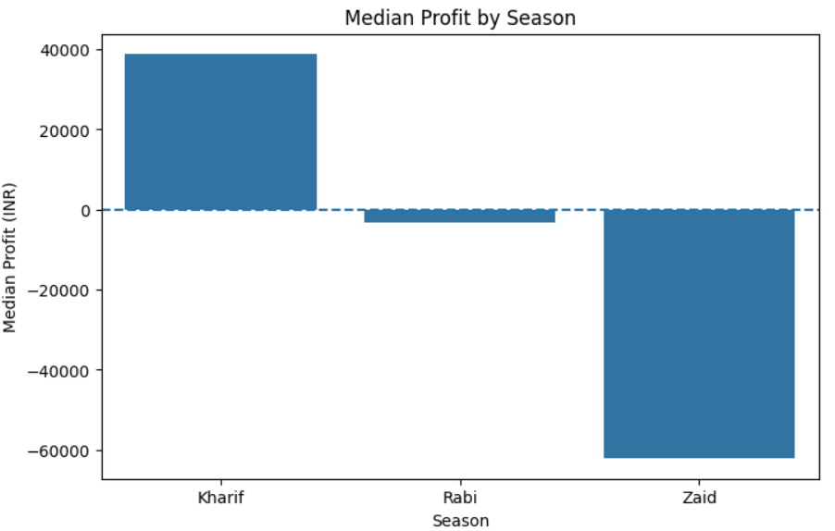
OVERALL SEASONAL PERFORMANCE
Kharif
Rabi
Zaid
Highest overall performance
Median yield: 1.94 t/ha
Median revenue: ₹520,196
Median profit: ₹38,808
Intermediate performance
Median yield: 1.67 t/ha
Median revenue: ₹439,588
Median profit: −₹3,187
Weakest overall performance
Median yield: 1.46 t/ha
Median revenue: ₹373,700
Median profit: −₹62,144
Kharif leads across the major performance indicators, while Zaid consistently records the weakest yield, revenue and profitability.

Slide 9
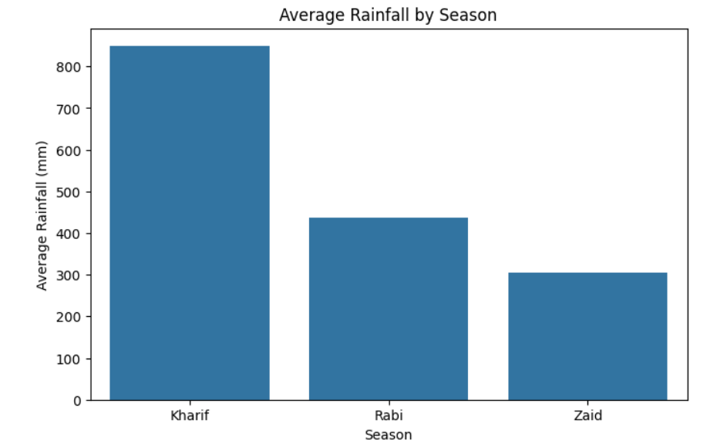
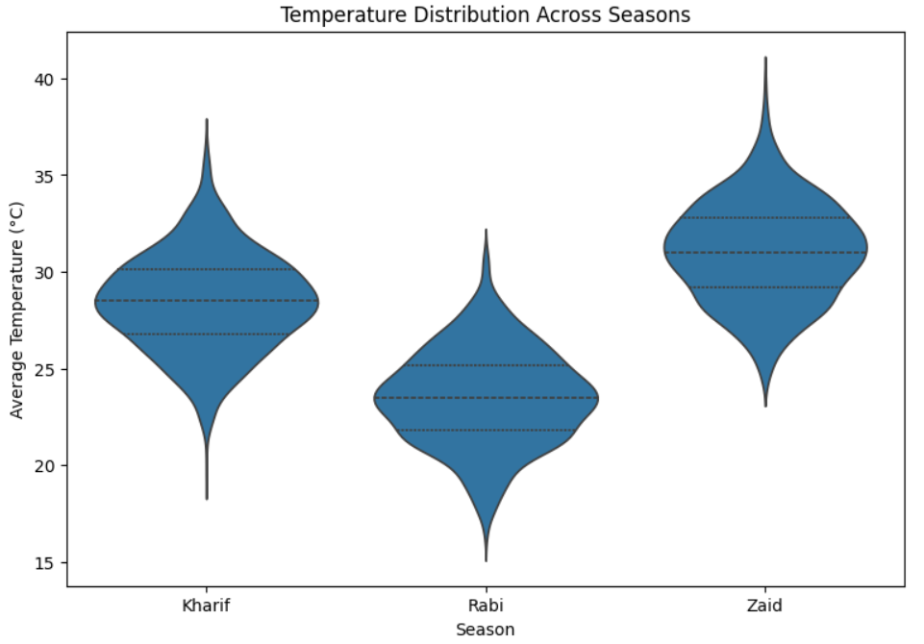
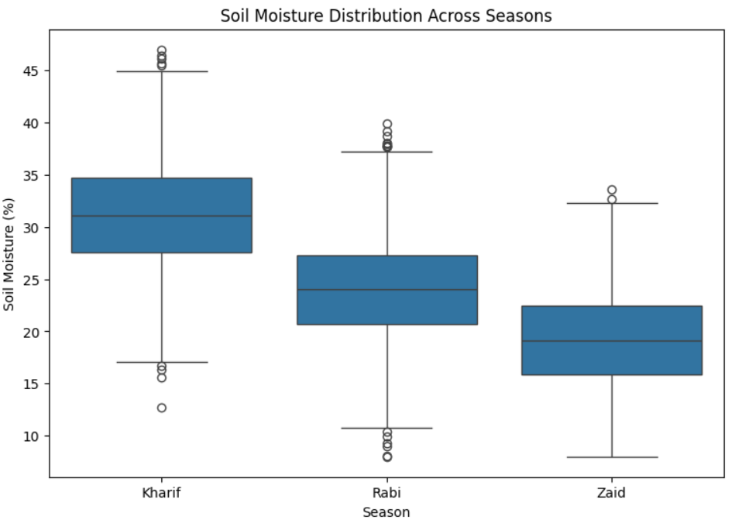
ENVIRONMENTAL CONDITIONS ACROSS SEASONS
Zaid is the hottest and driest season, while Kharif has the highest rainfall and soil moisture. However, these environmental differences alone do not explain yield differences.

Slide 10
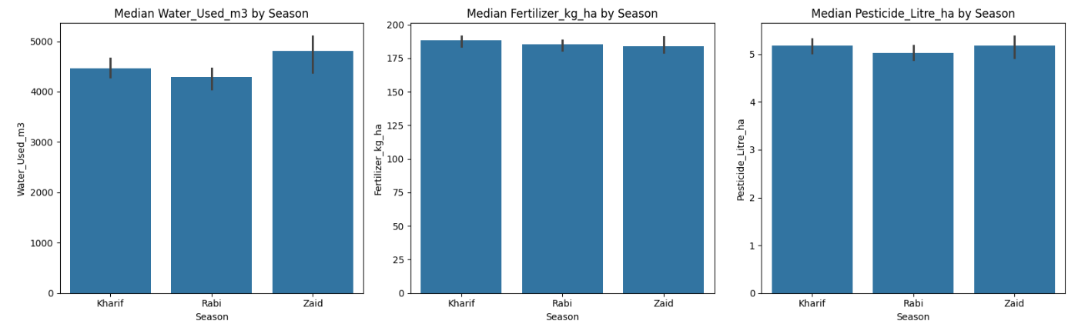
RESOURCE USAGE ACROSS SEASONS
None of the three resource inputs differ significantly by season (Kruskal-Wallis: Water p=0.051, Fertilizer p=0.59, Pesticide p=0.30) — farmers apply roughly constant input levels across Kharif, Rabi and Zaid, even though environmental conditions, yield and profit all vary sharply. Water usage came closest to significance, suggesting possible (but not yet strong) seasonal adjustment.

Slide 11
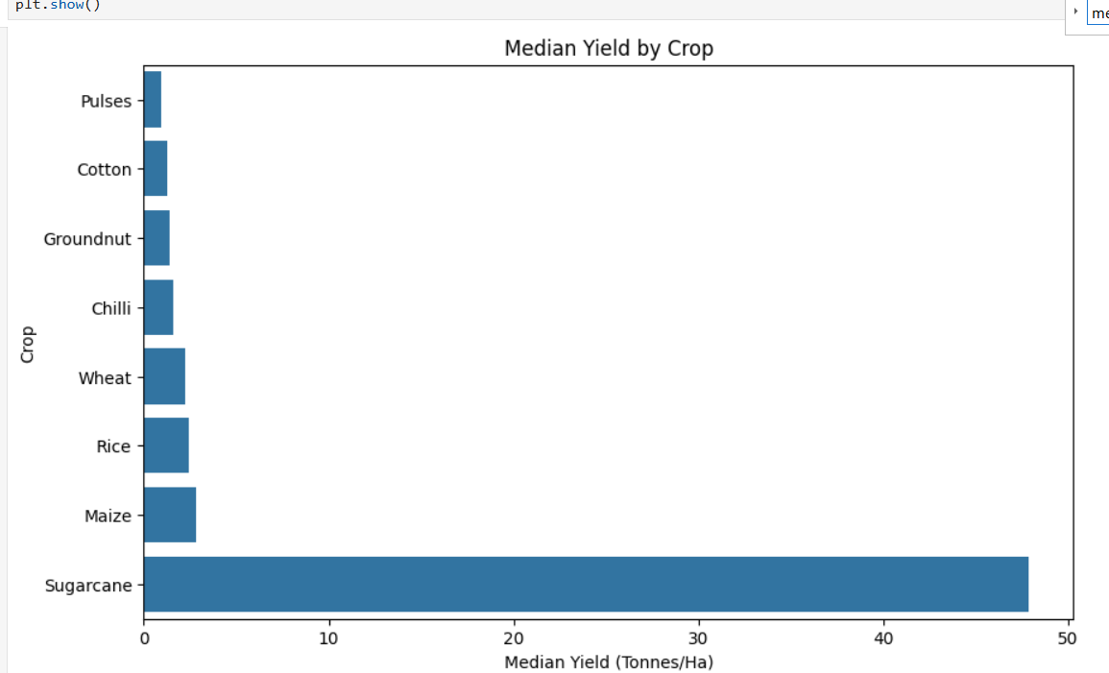
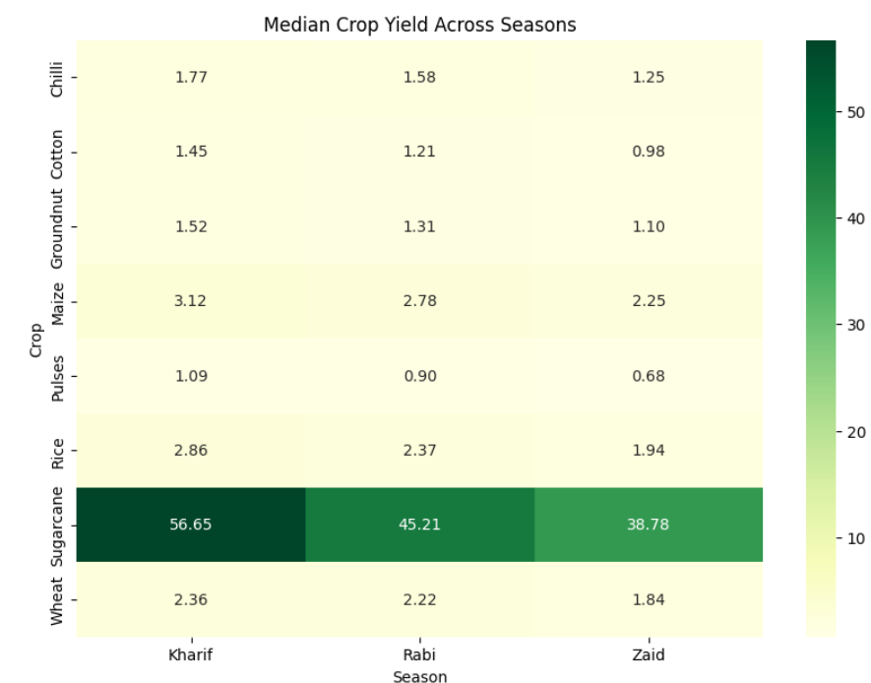
CROP-WISE YIELD PERFORMANCE
Sugarcane's median yield (47.9 t/ha) dwarfs every other crop. Across the other crops, yield is generally highest in Kharif and lowest in Zaid. Sugarcane has a substantially higher yield per hectare than the other crops in this dataset.

Slide 12
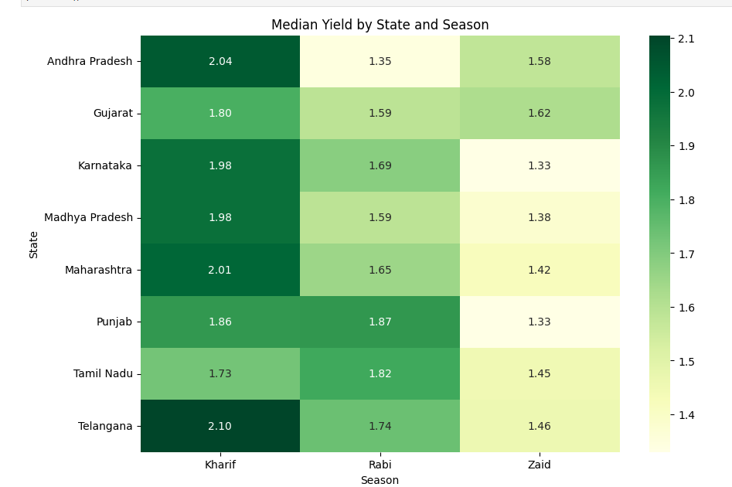
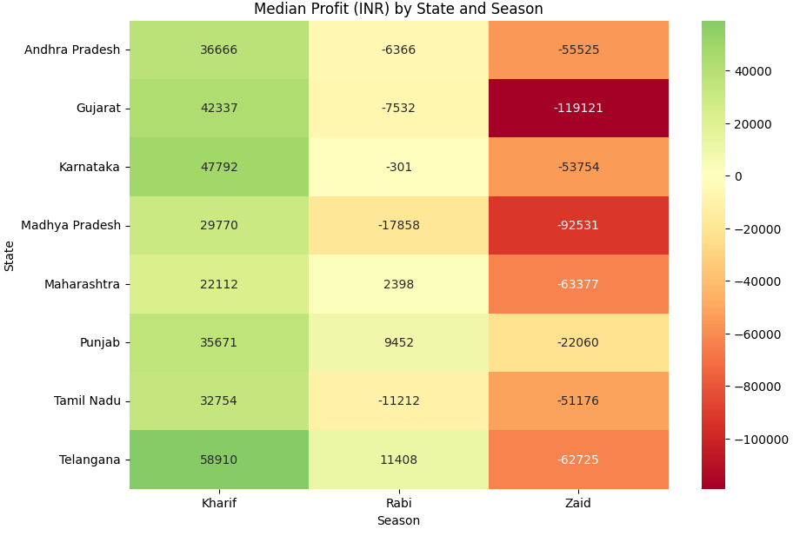
REGIONAL PATTERNS & STATISTICAL SIGNIFICANCE
Kruskal–Wallis test: Profit differs significantly across seasons (H = 101.93, p < 0.001). Every state records positive median profit in Kharif and negative median profit in Zaid, showing that the seasonal profitability pattern is consistent across regions. Yield also differs significantly across seasons (H = 68.71, p < 0.001).

Slide 13
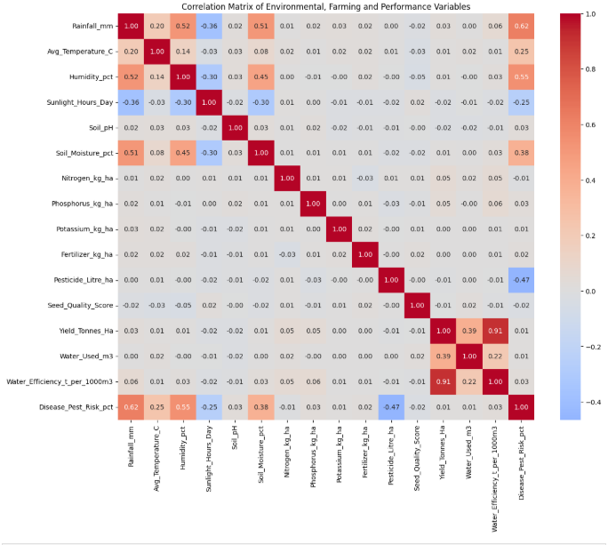
WHAT DRIVES YIELD? CORRELATION ANALYSIS
Correlation with Yield
Rainfall: 0.03
Soil Moisture: 0.01
Seed Quality: −0.01
Fertilizer Use: 0.00
Disease/Pest Risk: 0.01
None of the individual environmental or input variables shows a meaningful linear relationship with yield. Water efficiency correlates strongly with yield (0.91), but it is mathematically derived from yield itself and therefore should not be interpreted as an independent driver.
Crop type, season and irrigation practice explain more of the observed variation than any single environmental or farming input.

Slide 14
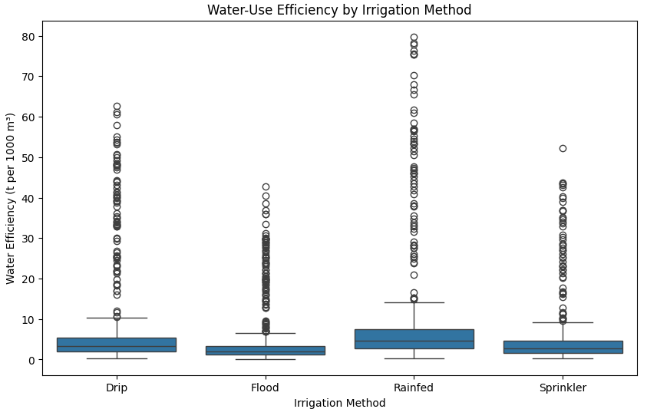
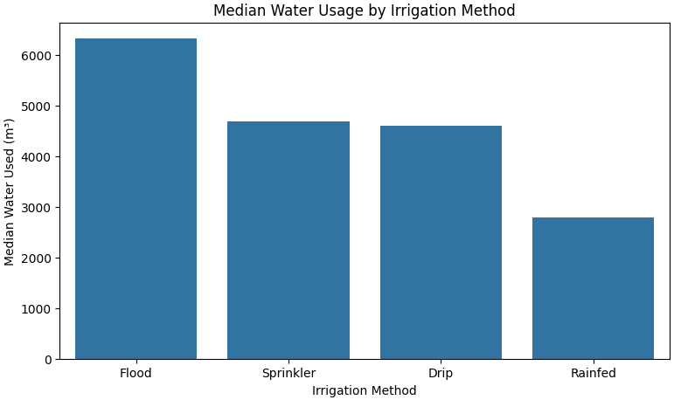
IRRIGATION & WATER EFFICIENCY
FLOOD Highest water use Median water use: 6,326 m³
RAINFED Highest water efficiency Median efficiency: 4.58 t/1,000 m³
DRIP Strong overall balance Median yield: 1.94 t/ha
SPRINKLER Immediate performance Median efficiency: 2.65 t/1,000 m³
Flood irrigation uses substantially more water, while Rainfed records the highest median water efficiency. Drip provides a comparatively strong balance between yield and water use.

Slide 15
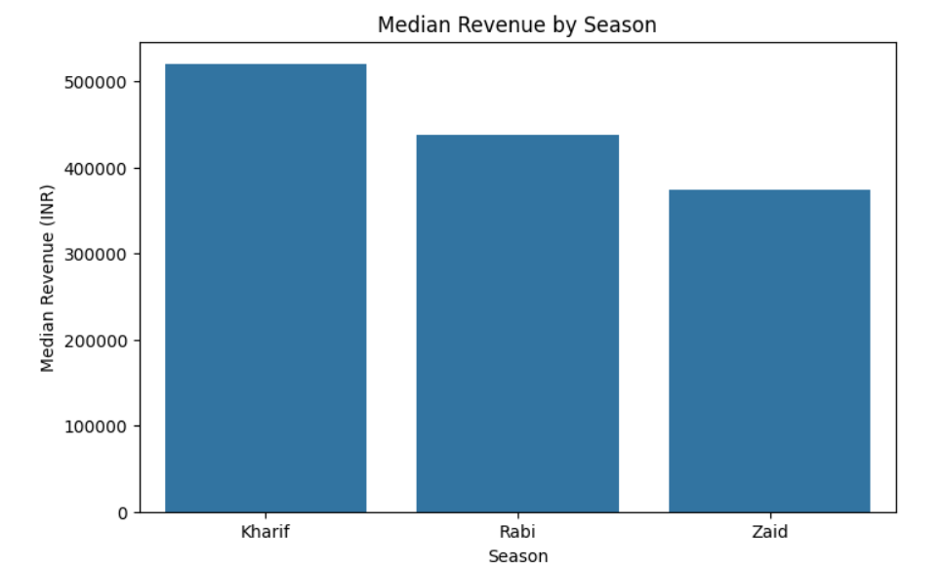
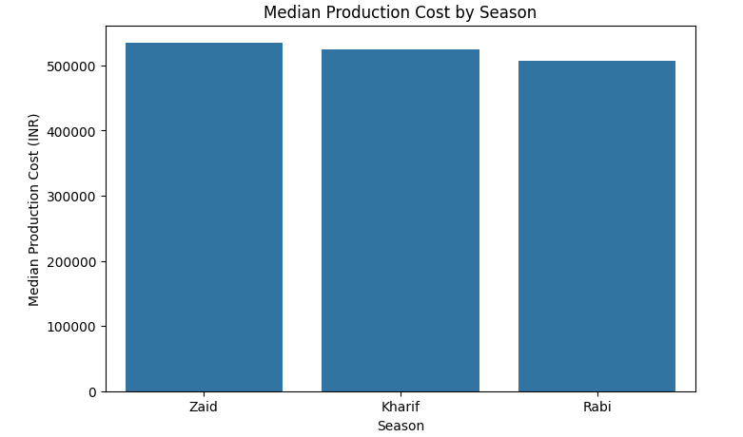
REVENUE & PRODUCTION COST ACROSS SEASONS
Kharif earns the highest median revenue (₹520,196) at a similar cost to the other seasons. Zaid combines the highest median production cost (₹534,833) with the lowest median revenue (₹373,700), contributing to its weak profitability.

Slide 16
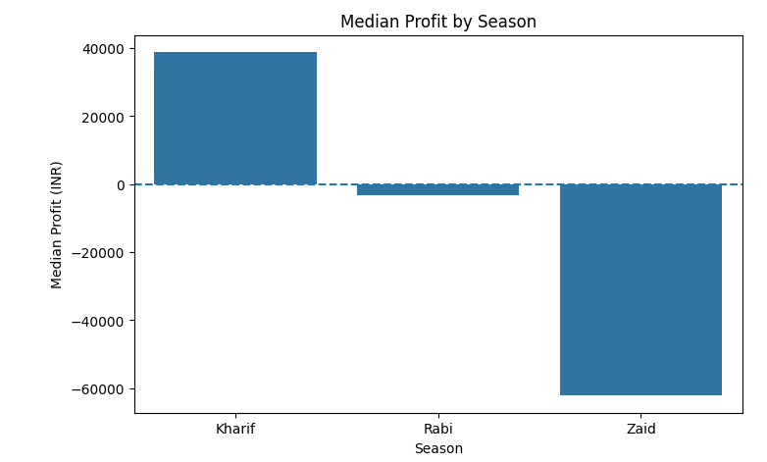
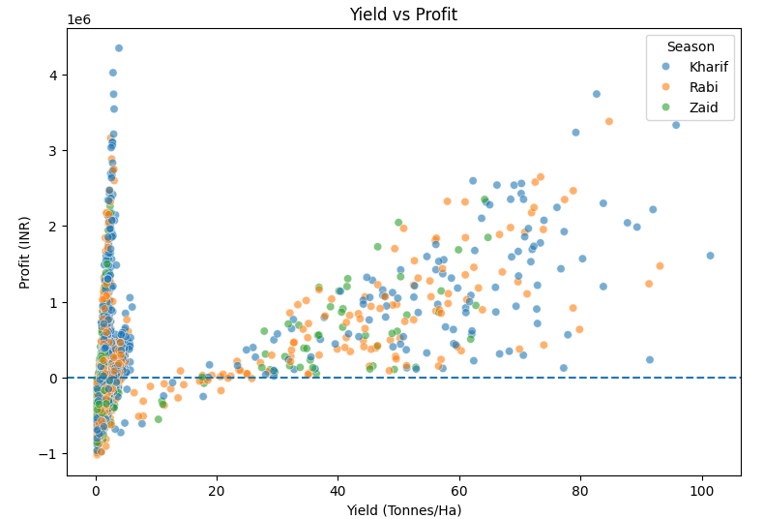
PROFITABILITY
Median Profit by Season Kharif → ₹38,808 Rabi → −₹3,187 Zaid → −₹62,144
Profitable farms Kharif → 57.79% Rabi → 48.86% Zaid → 35.52%
Kharif is the only season with positive median profit and has the highest share of profitable farms. Zaid performs worst on both measures.
Yield and profit are only moderately correlated (r ≈ 0.49), showing that higher production does not automatically translate into higher profitability.

Slide 17
KEY FINDINGS & CONCLUSION
Kharif leads overall Highest median yield, revenue and profit, with the strongest share of profitable farms
Zaid is the weak point Lowest median yield, revenue, water efficiency and profit, with only 35.5% profitable farms
Yield ≠ profit Yield and profit are only moderately correlated (r ≈ 0.49); production cost and crop economics matter too
Irrigation choice is season-dependent Drip performs strongly in Kharif and Rabi, while Sprinkler records the highest median yield in Zaid
Crop type matters Sugarcane's yield is substantially higher than every other crop in the dataset
Single inputs don't explain yield Rainfall, soil moisture, fertilizer and seed quality show near-zero linear correlation with yield
01
04
02
05
03
06

Slide 18
DATA-DRIVEN RECOMMENDATIONS
01
Prioritize seasonal planning Build on Kharif's strong conditions while targeting improvements for Rabi and especially Zaid.
02
Improve water management Shift from Flood toward Drip irrigation where feasible — it pairs high yield with lower water use.
03
Treat Zaid as the priority season Lowest yield, efficiency, revenue, profit and profitability rate (35.5%) make it the top improvement target.
04
Weigh crop economics, not yield alone Sugarcane's high yield does not mean planting it everywhere — factor in profitability per crop.
05
Don't rely on a single input Rainfall, soil moisture, fertilizer and seed quality show no meaningful individual linear relationship with yield.
06
Track profitability, not just production Evaluate farms on both output and economics — higher yield doesn't always mean higher profit.

Slide 19
FUTURE SCOPE
Predictive Yield & Profit Models
Build machine-learning models to estimate yield and profitability using multiple agricultural factors
Time-Series Analysis
Use multi-year data to identify long-term seasonal trends rather than relying on a single dataset snapshot
Interactive Dashboard
Develop a Power BI or Streamlit dashboard for season, crop, region and irrigation exploration
Weather & Historical Data Integration
Combine the dataset with longer-term weather and climate information
Crop & Irrigation Recommendations
Develop decision-support systems that provide region- and season-specific recommendations

Slide 20
GITHUB LINK
https://github.com/harshveekotak/Seasonal-Agriculture-Performance-Analysis.git

Slide 21

VOIS COURSE COMPLETION CERTIFICATE
COURSE NAME: DATA VISUALIZATION

Slide 22
THANK YOU
.
.

